Slide 1
Supervised Learning

Slide 2
Learning from experience is the key
Learn from past experience - In case of Machine learning it’s past labeled data

Slide 3
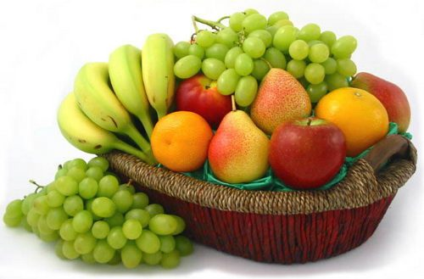
Experience
-------------------------Features----------------------------------
Response Variable / label
NO. | SIZE | COLOR | SHAPE | FRUIT NAME
1 | Big | Red | Rounded shape with a depression at the top | Apple
2 | Small | Red | Heart-shaped to nearly globular | Cherry
3 | Big | Green | Long curving cylinder | Banana
4 | Small | Green | Round to oval, Bunch shape Cylindrical | Grape
5 | Medium | Red | Round | ??????

Slide 4
Example 2
A Credit card company receives thousands of applications for new cards. Each application contains information about an applicant,
Age
Marital status
Annual Income
Outstanding debts
Credit rating
Problem: To decide whether an application should approved or rejected

Slide 5
Supervised Learning System
Algorithm
No - Experience
Training Phase
Model Parameter
Production Phase
Gathering Knowledge / Creating Memories

Slide 6
Supervised Learning
Recorded Data
Training
Set
ML
Algorithm
Model
Parameters
=
Test
Set
ML
Algorithm
Prediction
Accuracy
Unseen Input
ML
Algorithm
Prediction
Result

Slide 7
Training and Test Dataset
Sufficiently Variation on both data set is required for better production accuracy
In practice, even after training, this assumption is often violated to certain degree.
Out of Syllabus Question :P

Slide 8
Supervised Learning
One set of data called Training data consists of inputs data and correct responses corresponding to every piece of data
Based on this training data, the algorithm has to generalize such that it is able to correctly (or with a low margin of error) respond to all possible inputs
The algorithm should produce sensible outputs for inputs that weren't encountered during training.
Also called learning from examples

Slide 9
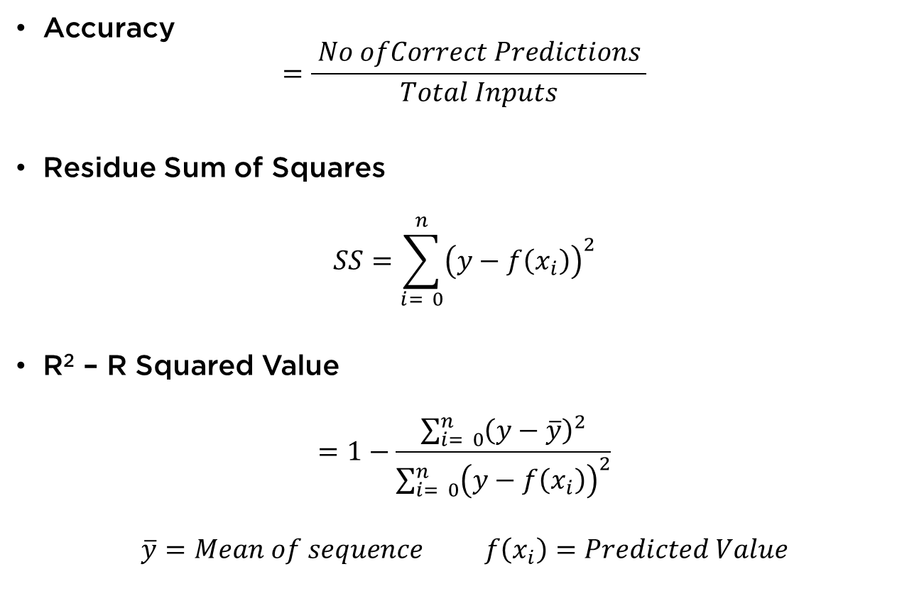
Performance Measurement (P)
Accuracy
$$=\frac{ No ofCorrect Predictions }{Total Inputs}$$
Residue Sum of Squares
$$SS=\sum_{i= 0}^{n}{{\left(y−f\left(x_{i}\right)\right)}^{2}}$$
R² – R Squared Value
$$=1−\frac{\sum_{i= 0}^{n}{{\left(y−\overline{y}\right)}^{2}}}{\sum_{i= 0}^{n}{{\left(y−f\left(x_{i}\right)\right)}^{2}}}$$
$$\overline{y}=Mean of sequence f\left(x_{i}\right)=Predicted Value$$

Slide 10
Supervised Learning
Regression
Continuous variable
Example: What be price of 10 item? How much gold cost after 2 years?
Classification
Discrete answers
Example: Stock trendline?, can India win world cup?

Slide 11
Linear Regression

Slide 12
Some definitions
Dependent Variable (Single Explanatory Variable)
Independent Variable (Response Variable)

Slide 13

Examples
Suppose you wish to know the price of a pizza
Estimation based on linear regression
Record | Pizza Size | Price
1 | 6 | 7
2 | 8 | 9
3 | 10 | 13
4 | 14 | 17.5
5 | 18 | 18
14 Inch
Menu Card
8 Inch
6 Inch

Slide 14
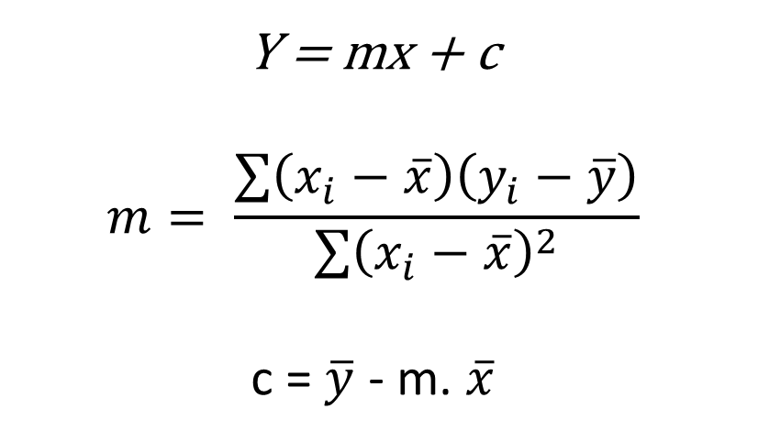
Ordinary Least Square Estimation
Y = mx + c
$$m= \frac{\sum{\left(x_{i}−\overline{x}\right)\left(y_{i}−\overline{y}\right)}}{\sum{{\left(x_{i}−\overline{x}\right)}^{2}}}$$
c = $\overline{y}$ - m. $\overline{x}$
Analytical Solution | Cost Function (MSE)

Slide 15
Mean Squared Error (Loss Function)

Slide 16
Stochastic Gradient Decent

Slide 17
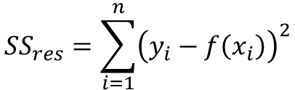
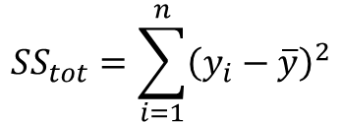

Evaluating Performance (R Square)
$${SS}_{tot}=\sum_{i=1}^{n}{{\left(y_{i}−\overline{y}\right)}^{2}}$$
$${SS}_{res}=\sum_{i=1}^{n}{{\left(y_{i}−f\left(x_{i}\right)\right)}^{2}}$$
$$R^{2}=1−\frac{{SS}_{res}}{{SS}_{tot}}$$

Slide 18
Evaluating Performance (K-Fold Cross Validation)
cross_val_score
cross_val_predict

Slide 19
Regression.ipynb

Slide 20
Multivariate Linear Regression

Slide 21
Regression.ipynb

Slide 22
Non-Linear (Polynomial) Regression

Slide 23
Converting Non-Linear to Linear
X Y
1 2
2 5
3 8
4 17
5 24
6 37
7 48

Slide 24
Overfitting of polynomial

Slide 25
Logistic Regression

Slide 26
Logistic Regression
LOGIT Function Explanation

Slide 27
Performance Metrics

Slide 28
Confusion Matrix
False Positives
True Negatives
Accuracy
Precision and Recall
F1-Score
ROC Curve

Slide 29
Accuracy - Accuracy is the most intuitive performance measure and it is simply a ratio of correctly predicted observation to the total observations. One may think that, if we have high accuracy then our model is best. Yes, accuracy is a great measure but only when you have symmetric datasets where values of false positive and false negatives are almost same. Therefore, you have to look at other parameters to evaluate the performance of your model. For our model, we have got 0.803 which means our model is approx. 80% accurate.
Accuracy = TP+TN/TP+FP+FN+TN

Slide 30
Precision - Precision is the ratio of correctly predicted positive observations to the total predicted positive observations. The question that this metric answer is of all passengers that labeled as survived, how many actually survived? High precision relates to the low false positive rate. We have got 0.788 precision which is pretty good.

Slide 31
Recall (Sensitivity) - Recall is the ratio of correctly predicted positive observations to the all observations in actual class - yes. The question recall answers is: Of all the passengers that truly survived, how many did we label? We have got recall of 0.631 which is good for this model as it’s above 0.5.
Recall = TP/TP+FN

Slide 32
References
https://www.youtube.com/watch?v=IyDwQNXDWns
Ref: http://blog.exsilio.com/all/accuracy-precision-recall-f1-score-interpretation-of-performance-measures/

